Slide 1
Online shoppers purchasing intention
Shreyas Kambla
INFO6105 Data Science Engineering Methods and Tools

Slide 2

Objective and features
Objective:
Online shopping growing at fast pace, expected to reach $900 Billion market
Get insight of the dataset and predict revenue pattern to improve online sales
Features:
~17 Features extracted form online user activity
Majors feature :
Online activity – Bounce rate, Exit rate
Duration spent on type of page like product page or information page
Type – Existing or new customer
Month

Slide 3
Correlating feature
Mostly widely used technique
Correlation helps
identify the associations
determine strength of other feature with targeted feature
For purchase intention study, strength of the associations helps recommend similar/best products to customers => increase the sales

Slide 4
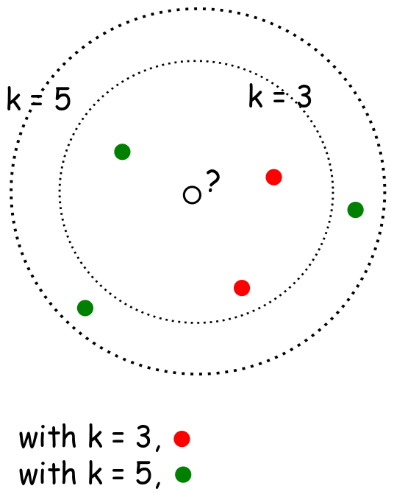
KNN Algorithm
Works on simple algorithm – predict outcome based on n nearest neighbors
Most important usage, predict the number of neighbors
achieve by elbow method
Hyper parameters [Eg. weight, algorithm, neighbors] are tuned and best parameters selected based on train dataset
Test results predicted based on best model selection

Slide 5

Random Forest
Learns and ensembles to predict classification result
Decision trees used to predict results
Mean prediction selected every time to over come overfit problem
Hyper parameter like leaf, depth ,split are tuned to select the best model
Provides best feature selection
Its one of the best approaches and always provides best accuracy result

Slide 6
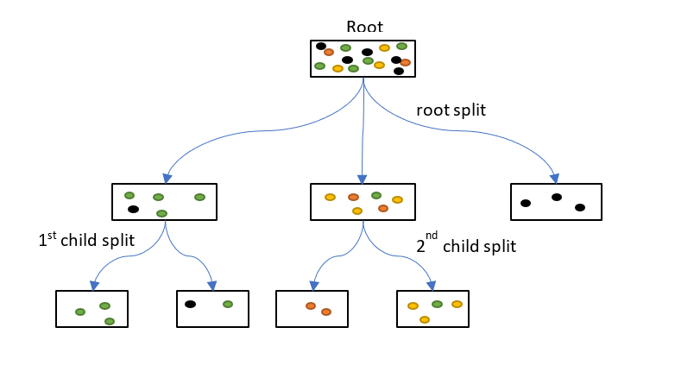
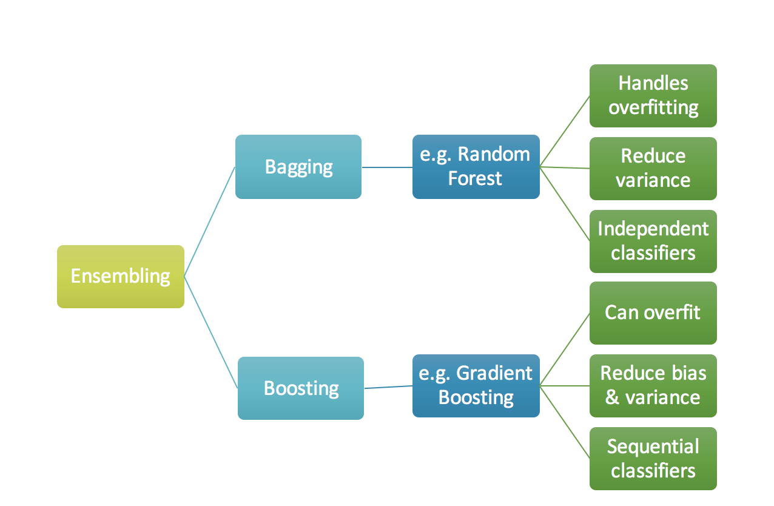
Gradient Classifier
Combines many weak learning models together to create a strong predictive model.
Similar to Random forest,
uses decision tree to predict the outcome
hyper parameters like learning rate ,depth etc are tuned
main difference, it implements sequential classifiers rather than independent classifiers in random forest
Best model selected and test results are predicted
Faster compared to Randomforest, In our dataset ,Gradient took 18 mins and random forest took 29 mins to execute

Slide 7
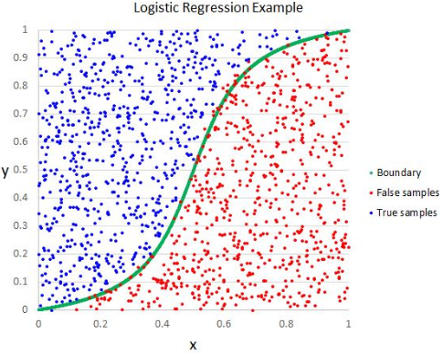
Logistic Regression
Main idea: To find relationship between features and probability of a particular outcome.
For this project Logistic regression model is built with default parameter
Model used to predict the test results
Future scope: implement feature elimination technique

Slide 8
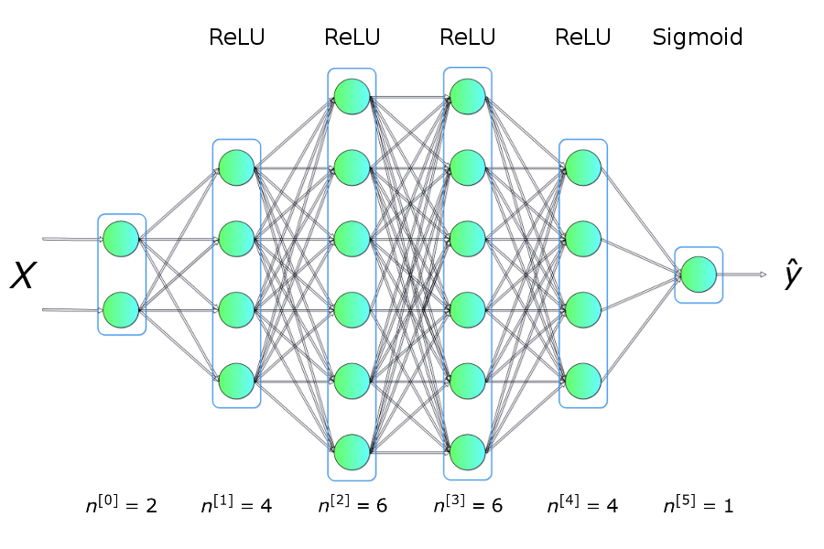
Dense neural network
Set of algorithms, modeled loosely after the human brain, designed to recognize patterns
Densely connected layer provides learning features from all combinations of features of the previous layer
Neurons are feature like Pagevalue
~17 input feature which will be input layer for this project each neuron is connected to 5/3 hidden layer
By using keras classifier, best model is selected to predict the test results
Model is trained for 50 epoch to minimize the loss and increase the accuracy

Slide 9
Model performance
Model | Accuracy
KNN | 82.10
Random Forest | 84.59
Gradient boost | 84.75
Logistic regression | 83.91
DNN | 83.91
5 different models built to predict the revenue
ROC curves are a plot for test sensitivity/True positive rate (y-axis) Vs specificity or false positive rate

Slide 10
Thank you

